Slide 1
Certificação
AWS Cloud Practitioner

Slide 2
Como estudar?
Com experiência na AWS
Sequência normal: Domínios 1, 2, 3 e 4
Sem experiência na AWS
Começar pelo domínio 3 para adquirir visão dos serviços

Slide 4
Certificações AWS
Foundational
Associate
Professional
Specialty
https://aws.amazon.com/pt/certification

Slide 5
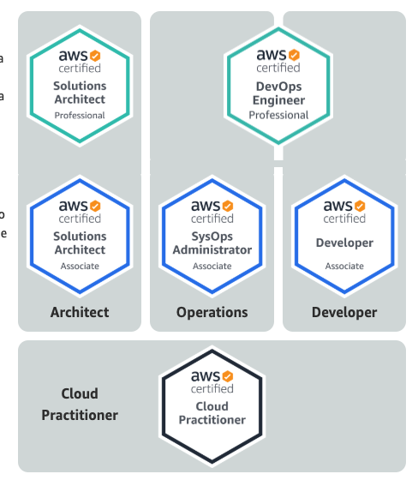
Certificações

Slide 6
Níveis de Certificação
Professional - Dois anos de soluções experiência abrangente criando, operando e solucionando problemas usando a Nuvem AWS
Associate - Um ano de experiência na solução de problemas e implementação de soluções usando a Nuvem AWS
Foundational - Seis meses de Nuvem AWS fundamental e conhecimento do setor

Slide 7
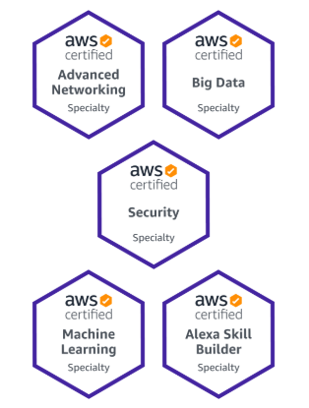
Certificações
Especialista

Slide 8
Níveis de Certificação
Specialty
Experiência técnica em Nuvem AWS no domínio Specialty conforme especificado no guia de exame

Slide 9
Por que certificar?
Validar sua experiência com a nuvem da AWS
Atesta e valoriza suas habilidades
Maior visibilidade no mercado de trabalho

Slide 11
Sobre a Certificação ACP

Slide 12
Certificação CCP - Público Alvo
Profissionais de TI
Consultores
Gerentes de Projetos
Gestores
...

Slide 13
Detalhes da certificação
Multipla escolha, Múltiplas respostas
Duração 90 minutos
Custo 100 USD*
Idioma - Inglês, japonês, coreano e chinês
Como é o Exame: Presencial ou Online

Slide 14
Como se preparar?
Curso
Documentação oficial AWS
Whitepapers AWS
Experiência Prática (6 meses) - Recomendação da AWS

Slide 15
Quais temas serão abordados no ACP?
Definições da nuvem da AWS
Compreender e explicar o modelo de responsabilidade compartilhada da AWS.
Compreender as práticas recomendadas de segurança da AWS Cloud.
Compreender os custos, a economia e as práticas de cobrança da AWS Cloud.
Descrever e apontar os principais serviços da AWS, incluindo computação, rede, bancos de dados e armazenamento.
Identificar os serviços da AWS para casos de uso comuns.

Slide 16
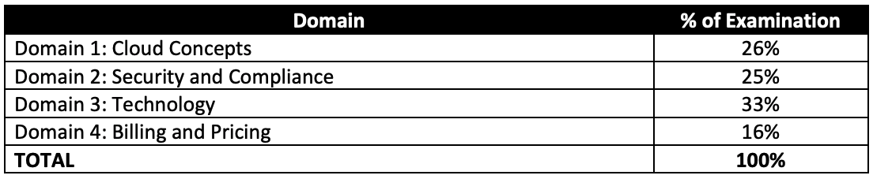
Divisão da Prova
Exam_guide
Nota para aprovação: >=70

Slide 17
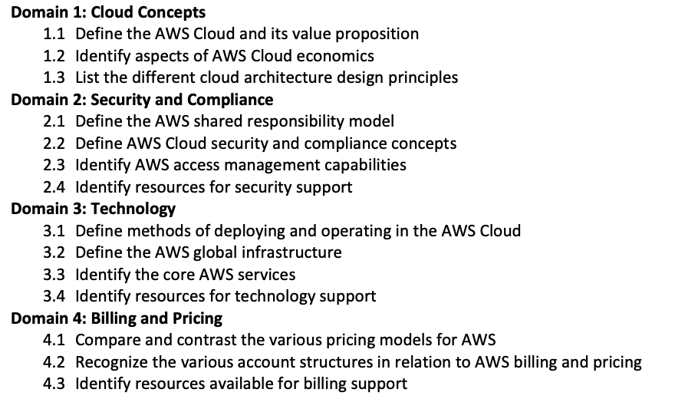
Estrutura do Curso

Slide 19
Domain 1: Cloud Concepts

Slide 20
What is Cloud Computing?
Cloud computing is the on-demand delivery of compute power, database storage, applications, and other IT resources through a cloud services platform via the Internet with pay-as-you-go pricing. Whether you are running applications that share photos to millions of mobile users or you’re supporting the critical operations of your business, a cloud services platform provides rapid access to flexible and low-cost IT resources.

Slide 21
What is Cloud Computing?
With cloud computing, you don’t need to make large upfront investments in hardware and spend a lot of time on the heavy lifting of managing that hardware. Instead, you can provision exactly the right type and size of computing resources you need to power your newest bright idea or operate your IT department. You can access as many resources as you need, almost instantly, and only pay for what you use

Slide 23
6 Advantages of Cloud Computing
Trade capital expense for variable expense
Benefit from massive economies of scale
Stop guessing capacity
Increase speed and agility
Stop spending money running and maintaining data centers
Go global in minutes

Slide 24
1-Trade capital expense for variable expense
Instead of having to invest heavily in data centers and servers before you know how you’re going to use them, you can pay only when you consume computing resources, and pay only for how much you consume

Slide 25
2-Benefit from massive economies of scale
By using cloud computing, you can achieve a lower variable cost than you can get on your own. Because usage from hundreds of thousands of customers is aggregated in the cloud, providers such as AWS can achieve higher economies of scale, which translates into lower pay as-you-go prices.

Slide 26
3-Stop guessing capacity
Eliminate guessing on your infrastructure capacity needs. When you make a capacity decision prior to deploying an application, you often end up either sitting on expensive idle resources or dealing with limited capacity. With cloud computing, these problems go away. You can access as much or as little capacity as you need, and scale up and down as required with only a few minutes’ notice

Slide 27
4-Increase speed and agility
In a cloud computing environment, new IT resources are only a click away, which means that you reduce the time to make those resources available to your developers from weeks to just minutes. This results in a dramatic increase in agility for the organization, since the cost and time it takes to experiment and develop is significantly lower

Slide 28
5-Stop spending money running and maintaining data centers
Focus on projects that differentiate your business, not the infrastructure. Cloud computing lets you focus on your own customers, rather than on the heavy lifting of racking, stacking, and powering servers.

Slide 29
6-Go global in minutes
Easily deploy your application in multiple regions around the world with just a few clicks. This means you can provide lower latency and a better experience for your customers at minimal cost.

Slide 31
Types of Cloud Computing
Infrastructure as a Service (IaaS)
Platform as a Service (PaaS)
Software as a Service (SaaS)

Slide 32
Infrastructure as a Service (IaaS)
Infrastructure as a Service (IaaS) contains the basic building blocks for cloud IT and typically provide access to networking features, computers (virtual or on dedicated hardware), and data storage space. IaaS provides you with the highest level of flexibility and management control over your IT resources and is most similar to existing IT resources that many IT departments and developers are familiar with today.

Slide 33
Platform as a Service (PaaS)
Platform as a Service (PaaS) removes the need for your organization to manage the underlying infrastructure (usually hardware and operating systems) and allows you to focus on the deployment and management of your applications. This helps you be more efficient as you don’t need to worry about resource procurement, capacity planning, software maintenance, patching, or any of the other undifferentiated heavy lifting involved in running your application.

Slide 34
Software as a Service (SaaS)
Software as a Service (SaaS) provides you with a completed product that is run and managed by the service provider. In most cases, people referring to Software as a Service are referring to end-user applications. With a SaaS offering you do not have to think about how the service is maintained or how underlying infrastructure is managed; you only need to think about how you will use that particular piece of software.

Slide 35
Cloud Computing Models
Public
Hybrid
Private (On-premises)

Slide 36
Public
A cloud-based application is fully deployed in the cloud and all parts of the application run in the cloud. Applications in the cloud have either been created in the cloud or have been migrated from an existing infrastructure to take advantage of the benefits of cloud computing. Cloud-based applications can be built on low-level infrastructure pieces or can use higher level services that provide abstraction from the management, architecting, and scaling requirements of core infrastructure
https://aws.amazon.com/pt/what-is-cloud-computing/

Slide 37
Hybrid
A hybrid deployment is a way to connect infrastructure and applications between cloud-based resources and existing resources that are not located in the cloud. The most common method of hybrid deployment is between the cloud and existing on-premises infrastructure to extend, and grow, an organization's infrastructure into the cloud while connecting cloud resources to the internal system.
https://aws.amazon.com/pt/hybrid/

Slide 38
Private (On-premises)
The deployment of resources on-premises, using virtualization and resource management tools, is sometimes called the “private cloud.” On-premises deployment doesn’t provide many of the benefits of cloud computing but is sometimes sought for its ability to provide dedicated resources. In most cases this deployment model is the same as legacy IT infrastructure while using application management and virtualization technologies to try and increase resource utilization.

Slide 40
Domain 2:
Security and Compliance

Slide 41
Cloud Security
Cloud security at AWS is the highest priority. As an AWS customer, you will benefit from a data center and network architecture built to meet the requirements of the most security-sensitive organizations. In the cloud, you use software-based security tools to monitor and protect the flow of information into and of out of your cloud resources.

Slide 42
Benefits of AWS Security
Keep Your Data Safe: All data is stored in highly secure AWS data centers.
Meet Compliance Requirements: AWS manages dozens of compliance programs in its infrastructure.
Save Money: Cut costs by using AWS data centers. Maintain the highest standard of security without having to manage your own facility
Scale Quickly: Security scales with your AWS Cloud usage.

Slide 43
Shared Responsibility Model
Security and Compliance is a shared responsibility between AWS and the customer. This shared model can help relieve the customer’s operational burden as AWS operates, manages and controls the components from the host operating system and virtualization layer down to the physical security of the facilities in which the service operates. The customer assumes responsibility and management of the guest operating system (including updates and security patches), other associated application software as well as the configuration of the AWS provided security group firewall.

Slide 44
Shared Responsibility Model
Customers should carefully consider the services they choose as their responsibilities vary depending on the services used, the integration of those services into their IT environment, and applicable laws and regulations. The nature of this shared responsibility also provides the flexibility and customer control that permits the deployment. The differentiation of responsibility is commonly referred to as Security “of” the Cloud versus Security “in” the Cloud.

Slide 45
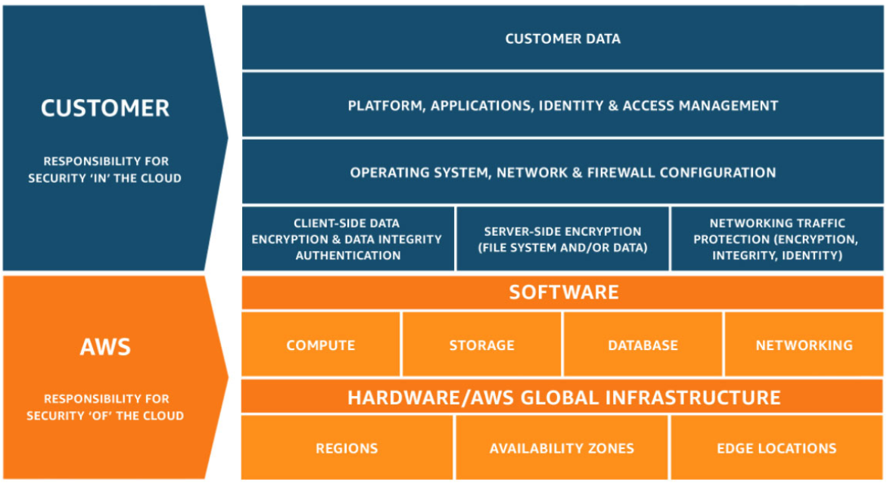
Shared Responsibility Model

Slide 46
AWS responsibility “Security of the Cloud”
AWS is responsible for protecting the infrastructure that runs all of the services offered in the AWS Cloud. This infrastructure is composed of the hardware, software, networking, and facilities that run AWS Cloud services.

Slide 47
Customer responsibility “Security in the Cloud”
Customer responsibility will be determined by the AWS Cloud services that a customer selects. This determines the amount of configuration work the customer must perform as part of their security responsibilities.

Slide 48
Customer responsibility “Security in the Cloud”
A service such as Amazon Elastic Compute Cloud (Amazon EC2) is categorized as Infrastructure as a Service (IaaS) and, as such, requires the customer to perform all of the necessary security configuration and management tasks. Customers that deploy an Amazon EC2 instance are responsible for management of the guest operating system (including updates and security patches), any application software or utilities installed by the customer on the instances, and the configuration of the AWS-provided firewall (called a security group) on each instance.

Slide 49
Customer responsibility “Security in the Cloud”
For abstracted services, such as Amazon S3 and Amazon DynamoDB, AWS operates the infrastructure layer, the operating system, and platforms, and customers access the endpoints to store and retrieve data. Customers are responsible for managing their data (including encryption options), classifying their assets, and using IAM tools to apply the appropriate permissions.

Slide 51
AWS Cloud Complice
AWS Compliance enablers build on traditional programs. This helps customers to establish and operate in an AWS security control environment.
The IT infrastructure that AWS provides to its customers is designed and managed in alignment with best security practices and a variety of IT security standards.

Slide 52
Compliance Programs
SOC 1/ISAE 3402, SOC 2, SOC 3
FISMA, DIACAP, and FedRAMP
PCI DSS Level 1
ISO 9001, ISO 27001, ISO 27017, ISO 27018
https://aws.amazon.com/compliance/programs/

Slide 53
AWS Artifact
AWS Artifact features a comprehensive list of access-controlled documents relevant to compliance and security in the AWS cloud.

Slide 55
Services - Security, Identity, & Compliance
Console - Services
WAF , Shield
Inspector, Trusted Advisor, CloudTrail
Cloudwatch, AWS Config
Athena, Macie

Slide 56
AWS WAF
AWS WAF is a web application firewall that helps protect your web applications or APIs against common web exploits that may affect availability, compromise security, or consume excessive resources. AWS WAF gives you control over how traffic reaches your applications by enabling you to create security rules that block common attack patterns, such as SQL injection or cross-site scripting, and rules that filter out specific traffic patterns you define.

Slide 57
AWS WAF
AWS WAF, you pay only for what you use. The pricing is based on how many rules you deploy and how many web requests your application receives. There are no upfront commitments.
You can deploy AWS WAF on Amazon CloudFront as part of your CDN solution, the Application Load Balancer that fronts your web servers or origin servers running on EC2, or Amazon API Gateway for your APIs.
https://aws.amazon.com/waf/pricing/

Slide 58
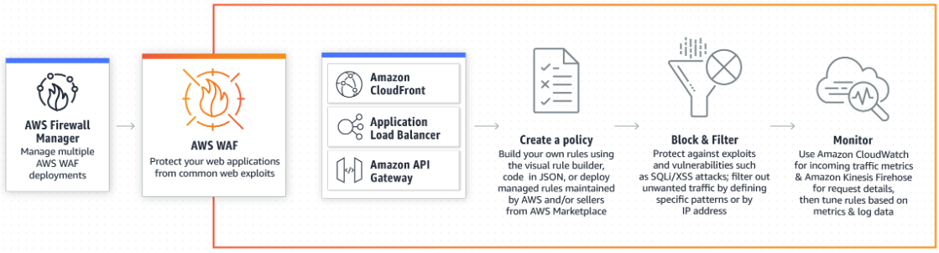
AWS WAF

Slide 60
AWS Shield - DDoS Protection
AWS Shield is a managed Distributed Denial of Service (DDoS) protection service that safeguards applications running on AWS. AWS Shield provides always-on detection and automatic inline mitigations that minimize application downtime and latency, so there is no need to engage AWS Support to benefit from DDoS protection. There are two tiers of AWS Shield - Standard and Advanced.

Slide 61
AWS Shield Standard
AWS Shield Standard provides always-on network flow monitoring which inspects incoming traffic to AWS and uses a combination of traffic signatures, anomaly algorithms and other analysis techniques to detect malicious traffic in real-time

Slide 62
AWS Shield Advanced
You can also mitigate application layer DDoS attacks by writing rules using AWS WAF. With AWS WAF you only pay for what you use.

Slide 63
AWS Shield Advanced
AWS Shield Advanced provides enhanced detection, inspecting network flows of traffic to your protected Elastic IP address, Elastic Load Balancing (ELB), Amazon CloudFront, AWS Global Accelerator or Amazon Route 53 resources. Using additional techniques like resource specific monitoring, AWS Shield Advanced uses resource and region specific granular detection of DDoS attacks. AWS Shield Advanced also detects application layer DDoS attacks like HTTP floods or DNS query floods by baselining traffic on your resource and identifying anomalies.

Slide 64
AWS Shield - Standard vs. Advanced
Standard
Automatically available on all AWS services.
Advanced
Amazon Route 53
Amazon CloudFront
Elastic Load Balancing
AWS Global Accelerator
Elastic IP (Amazon Elastic Compute Cloud and Network Load Balancer)
https://aws.amazon.com/shield/pricing/

Slide 66
Amazon Inspector
Amazon Inspector is an automated security assessment service that helps improve the security and compliance of applications deployed on AWS. Amazon Inspector automatically assesses applications for exposure, vulnerabilities, and deviations from best practices. After performing an assessment, Amazon Inspector produces a detailed list of security findings prioritized by level of severity. These findings can be reviewed directly or as part of detailed assessment reports which are available via the Amazon Inspector console or API.

Slide 67
Amazon Inspector
Amazon Inspector security assessments help you check for unintended network accessibility of your Amazon EC2 instances and for vulnerabilities on those EC2 instances.

Slide 68
Trusted Advisor
AWS Trusted Advisor is an online tool that provides you real time guidance to help you provision your resources following AWS best practices.
Whether establishing new workflows, developing applications, or as part of ongoing improvement, take advantage of the recommendations provided by Trusted Advisor on a regular basis to help keep your solutions provisioned optimally.

Slide 69
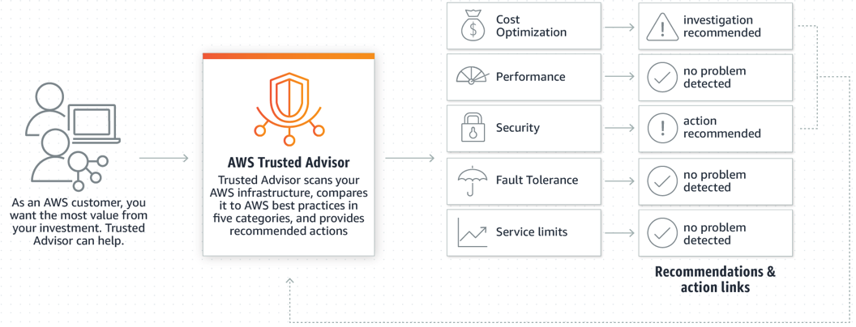
Trusted Advisor

Slide 70
CloudTrail
AWS CloudTrail is a service that enables governance, compliance, operational auditing, and risk auditing of your AWS account. With CloudTrail, you can log, continuously monitor, and retain account activity related to actions across your AWS infrastructure. CloudTrail provides event history of your AWS account activity, including actions taken through the AWS Management Console, AWS SDKs, command line tools, and other AWS services. This event history simplifies security analysis, resource change tracking, and troubleshooting. In addition, you can use CloudTrail to detect unusual activity in your accounts.

Slide 71
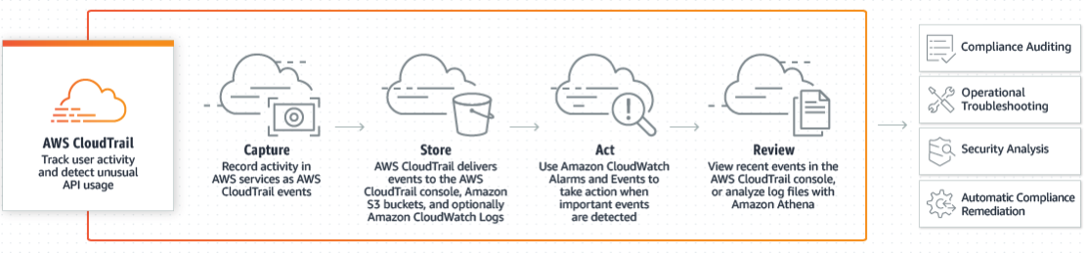
CloudTrail

Slide 73
CloudWatch
Amazon CloudWatch provides you with data and actionable insights to monitor your applications, respond to system-wide performance changes, optimize resource utilization, and get a unified view of operational health. CloudWatch collects monitoring and operational data in the form of logs, metrics, and events, providing you with a unified view of AWS resources, applications, and services that run on AWS and on-premises servers. You can use CloudWatch to detect anomalous, set alarms, visualize logs and metrics side by side, take automated actions and troubleshoot issues.

Slide 74
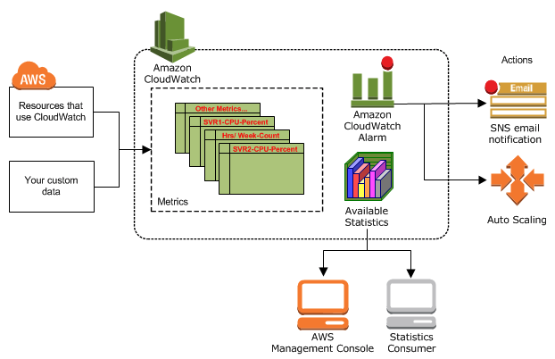
CloudWatch

Slide 75
AWS Config
AWS Config is a service that enables you to assess, audit, and evaluate the configurations of your AWS resources. Config continuously monitors and records your AWS resource configurations and allows you to automate the evaluation of recorded configurations against desired configurations. With Config, you can review changes in configurations and relationships between AWS resources, dive into detailed resource configuration histories, and determine your overall compliance against the configurations specified in your internal guidelines.

Slide 76
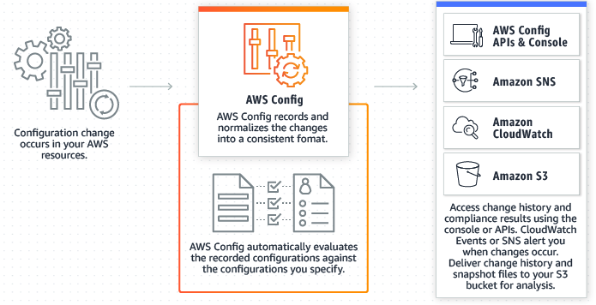
AWS Config

Slide 78
Athena
Amazon Athena is an interactive query service that makes it easy to analyze data in Amazon S3 using standard SQL. Athena is serverless, so there is no infrastructure to manage, and you pay only for the queries that you run.
Simply point to your data in Amazon S3, define the schema, and start querying using standard SQL. With Athena, there’s no need for complex ETL jobs to prepare your data for analysis. This makes it easy for anyone with SQL skills to quickly analyze large-scale datasets.

Slide 79
Macie
Amazon Macie is a security service that uses machine learning to automatically discover, classify, and protect sensitive data in AWS. Amazon Macie recognizes sensitive data such as personally identifiable information (PII) or intellectual property, and provides you with dashboards and alerts that give visibility into how this data is being accessed or moved. The fully managed service continuously monitors data access activity for anomalies, and generates detailed alerts when it detects risk of unauthorized access or inadvertent data leaks.

Slide 80
Macie
Today, Amazon Macie is available to protect data stored in Amazon S3, with support for additional AWS data stores coming later this year.

Slide 82
Resumo dos serviços
AWS WAF (Web Application Firewall) → Stop hackers (layer 7)
AWS Shield → Stop DDOS attacks (standard / advanced)
AWS Inspector → EC2 vulnerabilities
AWS Trusted Advisor → Inspect Account (Cost, Performance, Fault Tolerance)

Slide 83
Resumo dos serviços
CloudWatch → Monitoring
AWS CloudTrail → “Logs”
AWs Config → Gerenciamento das configs
Athena → Interactive query service (data stored in S3)
Macie → AI to analyze data in S3 (PII)

Slide 85
Domain 3: Technology

Slide 86
Global Infrastructure
The AWS Cloud infrastructure is built around AWS Regions and Availability Zones. An AWS Region is a physical location in the world where we have multiple Availability Zones. Availability Zones consist of one or more discrete data centers, each with redundant power, networking, and connectivity, housed in separate facilities. These Availability Zones offer you the ability to operate production applications and databases that are more highly available, fault tolerant, and scalable than would be possible from a single data center.

Slide 87
Global Infrastructure
The AWS Cloud operates in over 69 Availability Zones within over 22 geographic Regions around the world, with announced plans for more Availability Zones and Regions.

Slide 88
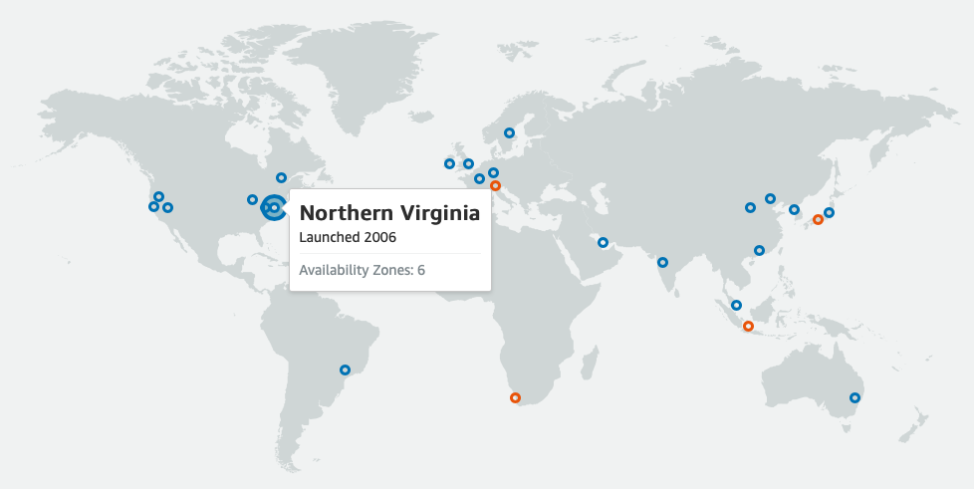
Regions & Availability Zones

Slide 90
Regions
Each Amazon Region is designed to be completely isolated from the other Amazon Regions. This achieves the greatest possible fault tolerance and stability.

Slide 91
Availability Zone
Each Availability Zone is isolated, but the Availability Zones in a Region are connected through low-latency links. AWS provides you with the flexibility to place instances and store data within multiple geographic regions as well as across multiple Availability Zones within each AWS Region. Each Availability Zone is designed as an independent failure zone.
Minimum of 2 availability zones per region

Slide 92
Availability Zone
Availability Zones are physically separated within a typical metropolitan region and are located in lower risk flood plains (specific flood zone categorization varies by AWS Region). In addition to discrete uninterruptible power supply (UPS) and onsite backup generation facilities, they are each fed via different grids from independent utilities to further reduce single points of failure. Availability Zones are all redundantly connected to multiple tier-1 transit providers.

Slide 93
Edge Locations
Edge Locations are endpoints for AWS which are used for caching content. Typically this consists os CloudFront, Amazon´s Content Delivery Network (CDN)

Slide 94
Infrastructure
Edge Locations > Availability Zones > Regions

Slide 96
Choosing the AWS Region
data storage laws
latency to end users
aws services

Slide 97
Access to Services
AWS Management Console
Command Line Interface (CLI)
Software Development Kits (SDKs).

Slide 99
Methods of Deploying and Operating in the AWS Cloud
Elastic Beanstalk
CloudFormation
OpsWorks
Code Commit
Code Deploy
CodePipeline
EC2 Container Services

Slide 100
AWS Elastic Beanstalk
AWS Elastic Beanstalk is an service for deploying and scaling web applications and services developed with Java, .NET, PHP, Node.js, Python, Ruby, Go, and Docker on familiar servers such as Apache, Nginx, Passenger, and IIS.
You can simply upload your code and Elastic Beanstalk automatically handles the deployment, from capacity provisioning, load balancing, auto-scaling to application health monitoring.
There is no additional charge for Elastic Beanstalk

Slide 101
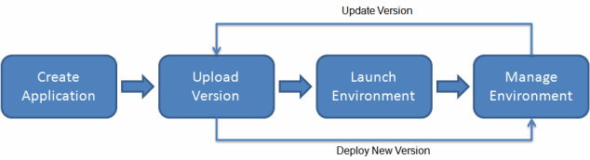
AWS Elastic Beanstalk

Slide 103
CloudFormation
AWS CloudFormation provides a common language for you to model and provision AWS and third party application resources in your cloud environment. AWS CloudFormation allows you to use programming languages or a simple text file to model and provision, in an automated and secure manner, all the resources needed for your applications across all regions and accounts.

Slide 104
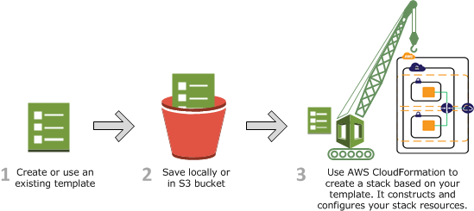
CloudFormation

Slide 106
OpsWorks
AWS OpsWorks is a configuration management service that provides managed instances of Chef and Puppet. Chef and Puppet are automation platforms that allow you to use code to automate the configurations of your servers. OpsWorks lets you use Chef and Puppet to automate how servers are configured, deployed, and managed across your Amazon EC2 instances or on-premises compute environments.

Slide 107
CodeCommit
AWS CodeCommit is a fully-managed source control service that hosts secure Git-based repositories. It makes it easy for teams to collaborate on code in a secure and highly scalable ecosystem. CodeCommit eliminates the need to operate your own source control system or worry about scaling its infrastructure. You can use CodeCommit to securely store anything from source code to binaries, and it works seamlessly with your existing Git tools.

Slide 108
Code Deploy
AWS CodeDeploy is a fully managed deployment service that automates software deployments to a variety of compute services such as Amazon EC2, AWS Fargate, AWS Lambda, and your on-premises servers.

Slide 109
CodePipeline
AWS CodePipeline is a fully managed continuous delivery service that helps you automate your release pipelines for fast and reliable application and infrastructure updates. CodePipeline automates the build, test, and deploy phases of your release process every time there is a code change, based on the release model you define. AWS CodePipeline, you only pay for what you use. There are no upfront fees or long-term commitments.

Slide 110
EC2 Container Services
Amazon Elastic Container Service (Amazon ECS) allows you to easily run, scale, and secure Docker container applications on AWS. Amazon ECS eliminates the need to install, operate, and scale your own container orchestration and cluster management infrastructure, and allows you to focus on the resource needs and availability requirements of your containerized application.

Slide 112
Global Services
IAM → Identity and Access Management
Route53 → DNS
CloudFront → CDN
SNS → Notification
SES → Email Service
S3*** → Regional Service with Global Vision

Slide 113
Services “On Premise”
Snowball → Data Transfer (Service / Hardware)
Storage Gateway → Hybrid cloud storage with local caching
CodeDeploy → Automate code deployments to maintain application uptime
Opsworks → Automate Operations with Chef and Puppet
IoT Greengrass → extends cloud capabilities to local devices

Slide 114
Basic Services
IAM - Identity and Access Management
S3 - Amazon Simple Storage Service
EC2 - Amazon Elastic Compute Cloud
IAM Roles - Permissions
Databases - RDS, DynamoDB

Slide 115
IAM - Identity and Access Management
AWS Identity and Access Management (IAM) enables you to securely control access to AWS services and resources for your users. Using IAM, you can create and manage AWS users and groups, and use permissions to allow and deny their access to AWS resources.

Slide 116
IAM - Identity and Access Management
Manage IAM users and their access
Manage IAM roles and their permissions
Manage federated users and their permissions

Slide 118
S3
Amazon Simple Storage Service (Amazon S3) is an object storage service that offers industry-leading scalability, data availability, security, and performance.
Amazon S3 is designed for 99.999999999% (11 9's) of durability, and stores data for millions of applications for companies all around the world.

Slide 119
S3 Features
Object-based
File size - 0 to 5TB
Key (name of the object)
Unlimited Storage
Storage in Buckets

Slide 120
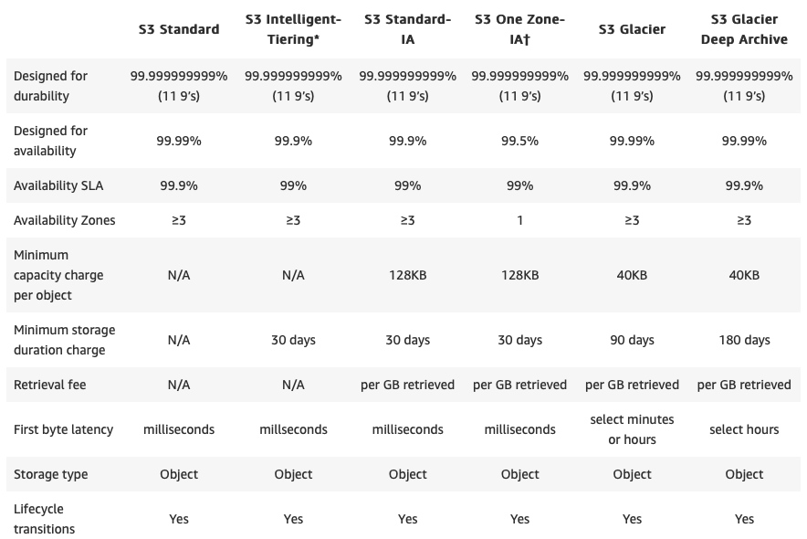
S3 - Storage Classes

Slide 122
EC2 - Elastic Compute Cloud
Amazon Elastic Compute Cloud (Amazon EC2) is a web service that provides secure, resizable compute capacity in the cloud. It is designed to make web-scale computing easier for developers.
Amazon EC2 reduces the time required to obtain and boot new server instances (called Amazon EC2 instances) to minutes, allowing you to quickly scale capacity, both up and down, as your computing requirements change.
Amazon EC2 changes the economics of computing by allowing you to pay only for capacity that you actually use.

Slide 123
EC2 Instance Types: On Demand
On-Demand Instances—With On-Demand instances, you pay for compute capacity by the hour with no long-term commitments. You can increase or decrease your compute capacity depending on the demands of your application and only pay the specified hourly rate for the instances you use.
The use of On-Demand instances frees you from the costs and complexities of planning, purchasing, and maintaining hardware and transforms what are commonly large fixed costs into much smaller variable costs. On-Demand instances also remove the need to buy “safety net” capacity to handle periodic traffic spikes.

Slide 124
EC2 Instance Types: Reserved Instances
Reserved Instances provide you with a significant discount (up to 75%) compared to On-Demand instance pricing. You have the flexibility to change families, operating system types, and tenancies while benefitting from Reserved Instance pricing when you use Convertible Reserved Instances.

Slide 125
EC2 Instance Types: Spot Instances
Spot Instances are available at up to a 90% discount compared to On-Demand prices and let you take advantage of unused EC2 capacity in the AWS Cloud. You can significantly reduce the cost of running your applications, grow your application’s compute capacity and throughput for the same budget, and enable new types of cloud computing applications.

Slide 126
EC2 Instance Types: Dedicated Hosts
An Amazon EC2 Dedicated Host is a physical server with EC2 instance capacity fully dedicated to your use. Dedicated Hosts can help you address compliance requirements and reduce costs by allowing you to use your existing server-bound software licenses.

Slide 128
IAM Roles
An IAM role is an IAM entity that defines a set of permissions for making AWS service requests. IAM roles are not associated with a specific user or group. Instead, trusted entities assume roles, such as IAM users, applications, or AWS services such as EC2.
IAM roles allow you to delegate access with defined permissions to trusted entities without having to share long-term access keys.

Slide 130
Amazon RDS
Amazon Relational Database Service (Amazon RDS) provides cost-efficient and resizable capacity while automating time-consuming administration tasks such as hardware provisioning, database setup, patching and backups.
Amazon RDS is available on several database instance types - optimized for memory, performance or I/O - and provides you with six familiar database engines to choose from, including Amazon Aurora, PostgreSQL, MySQL, MariaDB, Oracle Database, and SQL Server.

Slide 131
DynamoDB
Amazon DynamoDB is a key-value and document database that delivers single-digit millisecond performance at any scale. It's a fully managed, multiregion, multimaster database with built-in security, backup and restore, and in-memory caching for internet-scale applications. DynamoDB can handle more than 10 trillion requests per day and support peaks of more than 20 million requests per second.
DynamoDB is a NoSQL database

Slide 133
Elastic Load Balance (ELB) & Auto Scaling
Elastic Load Balancing (ELB) automatically distributes incoming application traffic across multiple targets, such as Amazon EC2 instances, containers, and IP addresses. It can handle the varying load of your application traffic in a single Availability Zone or across multiple Availability Zones. Elastic Load Balancing offers three types of load balancers that all feature the high availability, automatic scaling, and robust security necessary to make your applications fault tolerant.

Slide 134
ELB Types
Application Load Balancer is best suited for load balancing of HTTP and HTTPS traffic
Network Load Balancer is best suited for load balancing of TCP traffic where extreme performance is required.
Classic Load Balancer operate at both the request level and connection level. Classic Load Balancer is intended for applications that were built within the EC2-Classic network.

Slide 135
Auto Scaling
Amazon EC2 Auto Scaling helps you maintain application availability and allows you to automatically add or remove EC2 instances according to conditions you define.
You can also use the dynamic and predictive scaling features of Amazon EC2 Auto Scaling to add or remove EC2 instances. Dynamic scaling responds to changing demand and predictive scaling automatically schedules the right number of EC2 instances based on predicted demand.

Slide 137
Well-Architected Framework
The Well-Architected Framework has been developed to help cloud architects build secure, high-performing, resilient, and efficient infrastructure for their applications. Based on five pillars — operational excellence, security, reliability, performance efficiency, and cost optimization — the Framework provides a consistent approach for customers and partners to evaluate architectures, and implement designs that will scale over time.
Well-Architected Framework

Slide 139
AWS Support
AWS Support offers a range of plans that provide access to tools and expertise that support the success and operational health of your AWS solutions. All support plans provide 24x7 access to customer service, AWS documentation, whitepapers, and support forums. For technical support and more resources to plan, deploy, and improve your AWS environment, you can select a support plan that best aligns with your AWS use case.

Slide 140
Support Plans
Basic - FREE
Developer - If you are experimenting or testing in AWS.
Business - If you have production workloads in AWS.
Enterprise - If you have business and/or mission critical workloads in AWS.
https://aws.amazon.com/premiumsupport/plans/

Slide 141
Domain 4: Billing and Pricing

Slide 142
How do you pay for AWS?
Pay-as-you-go
Save when you reserve
Pay less by using more

Slide 143
Pay-as-you-go
Pay-as-you-go pricing allows you to easily adapt to changing business needs without overcommitting budgets and improving your responsiveness to changes. With a pay as you go model, you can adapt your business depending on need and not on forecasts, reducing the risk or over provisioning or missing capacity.

Slide 144
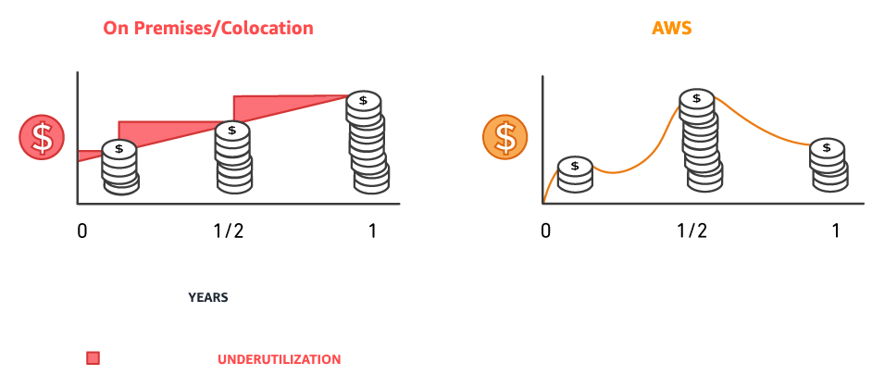
Pay-as-you-go

Slide 145
Save when you reserve
For certain services like Amazon EC2 and Amazon RDS, you can invest in reserved capacity. With Reserved Instances, you can save up to 75% over equivalent on-demand capacity.
Reserved Instances are available in 3 options:
All up-front (AURI)
Partial up-front (PURI)
No upfront payments (NURI)

Slide 146
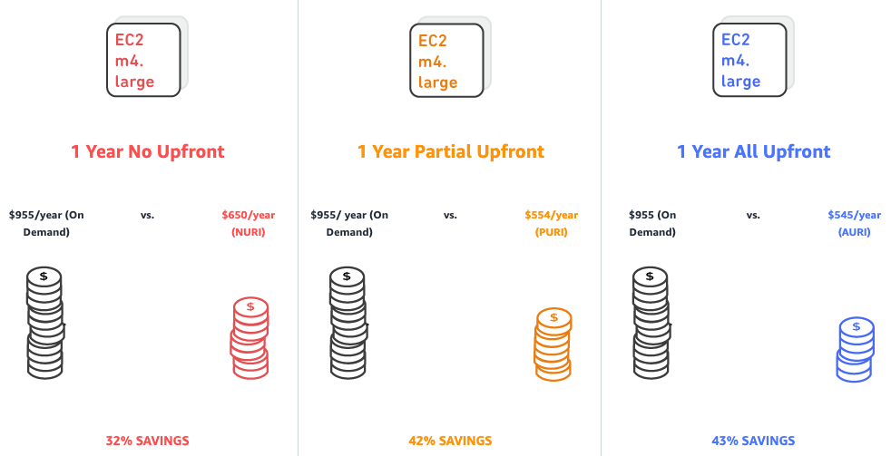
Save when you reserve

Slide 147
Pay less by using more
With AWS, you can get volume based discounts and realize important savings as your usage increases. For services such as S3 and data transfer OUT from EC2, pricing is tiered, meaning the more you use, the less you pay per GB. In addition, data transfer IN is always free of charge. As a result, as your AWS usage needs increase, you benefit from the economies of scale that allow you to increase adoption and keep costs under control.

Slide 148
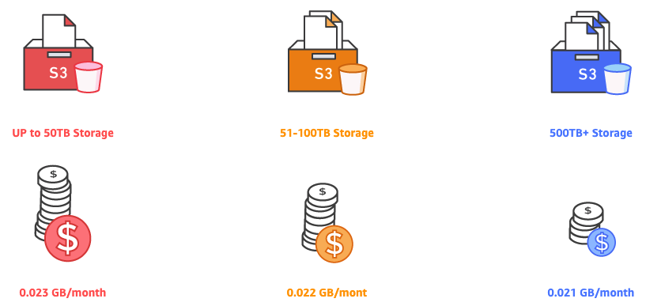
Pay less by using more

Slide 150
Understand the fundamentals of pricing
There are three fundamental drivers of cost with AWS: compute, storage, and outbound data transfer. These characteristics vary somewhat, depending on the AWS product and pricing model you choose.
In most cases, there is no charge for inbound data transfer or for data transfer between other AWS services within the same region. There are some exceptions, so be sure to verify data transfer rates before beginning.
https://d1.awsstatic.com/whitepapers/aws_pricing_overview.pdf

Slide 151
AWS Billing and Cost Management
AWS Billing and Cost Management is the service that you use to pay your AWS bill, monitor your usage, and analyze and control your costs.

Slide 152
Features in Billing and Cost Management
Estimate and plan your AWS costs
Receive alerts if your costs exceed a threshold that you set
Assess your biggest investments in AWS resources
Simplify your accounting if you work with multiple AWS accounts

Slide 153
AWS Budgets & Cost Explorer
AWS Budgets gives you the ability to set custom budgets that alert you when your costs or usage exceed (or are forecasted to exceed) your budgeted amount.
BEFORE
AWS Cost Explorer has an easy-to-use interface that lets you visualize, understand, and manage your AWS costs and usage over time.
AFTER

Slide 155
Free Services
Amazon VPC
Elastic Beanstalk
CloudFormation
IAM
AutoScaling
Opsworks

Slide 156
AWS Free Tier
The AWS Free Tier enables you to gain free, hands-on experience with the AWS platform, products, and services. AWS Free Tier includes offers that expire 12 months after sign-up, Always free and Trials.
https://aws.amazon.com/free/

Slide 158
Estimating Amazon EC2 costs
Clock hours of server time
Instance type
Pricing model
Number of instances
Load balancing
Detailed monitoring
Auto Scaling
Elastic IP addresses
Operating systems and software packages

Slide 159
AWS Lambda pricing
Duration is calculated from the time your code begins executing until it returns or otherwise terminates, rounded up to the nearest 100 milliseconds. The price depends on the amount of memory you allocate to your function.

Slide 160
How Amazon EBS is priced
Volumes
Snapshots
Data Transfer

Slide 161
Estimating Amazon S3 storage costs
Storage Class
Storage
Requests
Data transfer

Slide 162
Estimating Amazon RDS costs
Clock hours of server time
Database characteristics
Database purchase type
Number of database instances
Provisioned storage
Additional storage
Requests
Deployment type
Data transfer

Slide 164
Resource Groups
You can use resource groups to organize your AWS resources. Resource groups make it easier to manage and automate tasks on large numbers of resources at one time.

Slide 165
Tags for Cost Allocation
AWS Cost Explorer and detailed billing reports support the ability to break down AWS costs by tag. Typically, customers use business tags such as cost center/business unit, customer, or project to associate AWS costs with traditional cost-allocation dimensions. However, a cost allocation report can include any tag. This allows customers to easily associate costs with technical or security dimensions, such as specific applications, environments, or compliance programs.

Slide 167
AWS Organizations
AWS Organizations is an account management service that enables you to consolidate multiple AWS accounts into an organization that you create and centrally manage. AWS Organizations includes account management and consolidated billing capabilities that enable you to better meet the budgetary, security, and compliance needs of your business. As an administrator of an organization, you can create accounts in your organization and invite existing accounts to join the organization.

Slide 168
Features
Manage and define your organization and accounts
Control access and permissions
Audit, monitor, and secure your environment for compliance
Share resources across accounts
Centrally manage costs and billing

Slide 169
AWS Account Structures
AWS Organizations to create hierarchical and logical groupings to better manage accounts. Note that there is a soft limit of 20 accounts per organization, and a hard limit of one level of billing hierarchy; for example, a master (paying) account cannot be in the same organization as another master (paying) account.
https://aws.amazon.com/answers/account-management/aws-multi-account-billing-strategy/

Slide 171
AWS Calculators
AWS Pricing Calculator
TCO Calculator

Slide 172
AWS Pricing Calculator
The calculator allows you to estimate individual or multiple prices and use templates to appraise complete solutions.
https://calculator.aws/

Slide 173
TCO Calculator
The AWS TCO calculator gives you the option to evaluate the savings from using AWS and comparing against on premises and co-location environments. The TCO calculator matches your current infrastructure to the most cost effective AWS offering. This tool takes into consideration all the costs to run a solution, including physical facilities, power and cooling, providing a realistic end-to-end comparison of your costs.
https://aws.amazon.com/tco-calculator/

